Slide 1


[MIE1517 Project]
Deep-learning-based
Distracted Driver Detection
Team 24
Xinyuan Zhu 1007352865
Changda Li 1000371251
Sheida Saffari 1007524706
Pai Peng 1002725394

Slide 2
Problem Statement
$102.3 million/year insurance cost for distracted drivings in Canada | 21% of road fatalities is caused by distracted driving in Canada | 3.6 times increased likelihood of collision when using an electronic device while driving
Initiated by insurance company to see if dashboard cameras can capture distracted drivers
Our code and models can be transformed to real applications with a camera installed inside the car.
Ref: https://hellosafe.ca/en/car-insurance/distracted-driving-cost
Notes:
It is estimated that 8 in 10 accidents involves distracted driving and it’s a direct cause of ⅕ of all car accident fatalities in Canada.
The original problem is initiated by insurance company to see if dashboard cameras can capture distracted drivers.
Our code and models can be transformed to real applications with a camera installed inside the car.

Slide 3
End-to-end Pipeline
2. Transformations
Without Augmentation [in all Models]
With Augmentation [in VGG16] RandomRotation + ColorJitter + RandomResizedCrop + RandomHorizontalFlip
Downsize [in Baseline]
Grayscale + Resize
1. Data Loading
10 categories：
1 safe driving + 9 distracted driving behaviours
3. Model Design & Training
 | VGG16 | ResNet18 | AlexNet | Baseline CNN
# of params | 119,586,826 | 5,130 | 54,575,114 | 51,735,594
Features | Very Deep | Residual Blocks | Faster? | Light- weight
4. Testing
Quantitative:
Test accuracy Confusion matrix
Qualitative:
GradCAM
Real-world videos
Train for 10 ~ 30 epochs
batch size = 64, learning rate = 0.001
Notes:
First we loaded the data from Kaggle. Then we applied several transformations to the raw images as different ways of pre-processing. Next, we designed the four models, VGG16, ResNet18, AlexNet using transfer learning and our own baseline CNN.
Finally, we tested the model performance using two categories of metrics. To analyze the models quantitatively, we used test accuracy and confusion matrix. We also evaluated the model performance qualitatively with GradCAM and some real-world videos.

Slide 4
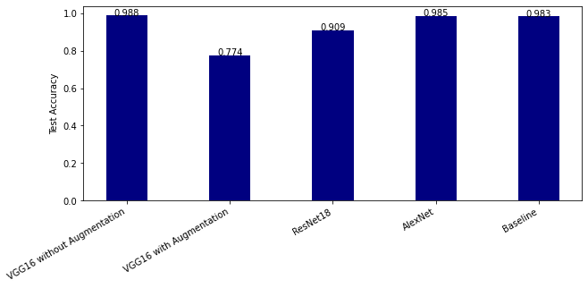
Results
Accuracies
Inferior performance of VGG16 trained with augmented data
Notes:
We also present the confusion matrices showing predictions vs. true labels for each of the ten classes. There are some noteworthy patterns.
VGG16 model trained with augmented images suffers from high false negative rate, meaning that the model tends to misclassify distracted driving behaviours as safe driving. It is especially undesirable if the model needs to be implemented in real application

Slide 5
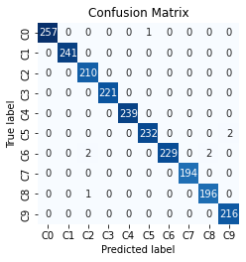
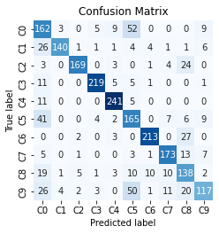
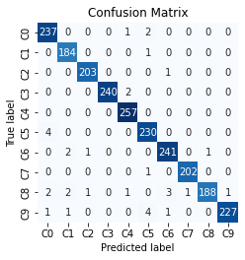

Results
Confusion Matrices
Overall accurate classification, but…
VGG16 W/O Aug: misclassify C5 and C6
VGG16 with Aug: lots of false negativity -> undesirable!
ResNet18: misclassify C8 and C9
AlexNet: misclassify C9
Baseline: misclassify C1, C7 and C8, some false negativity
VGG16 (W/O Aug)
VGG16 (with Aug)
AlexNet
Baseline
Notes:
We also present the confusion matrices showing predictions vs. true labels for each of the ten classes. There are some noteworthy patterns.
VGG16 model trained with augmented images suffers from high false negative rate, meaning that the model tends to misclassify distracted driving behaviours as safe driving. It is especially undesirable if the model needs to be implemented in real application

Slide 6

Demonstration - Still Images from Test Data
Red dot on the top left is our prediction
Achieved a decent result on the test image that never exposed to the training pipeline.
Robust to different lighting scenarios due to normalization and augmentation on pre-trained data
False positivity mostly happen between holding a phone or drinking.

Slide 7
Demonstration - Real World Video
Prediction time < 10ms, suitable for real-time processing.
The input image size is 640*480. Such application can be used for streaming with low latency.
Less accurate as input image are taken differently
Likely to make false prediction when there is a movement

Slide 8
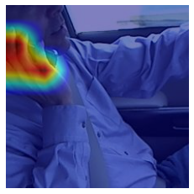
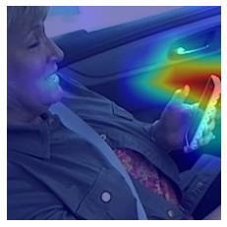
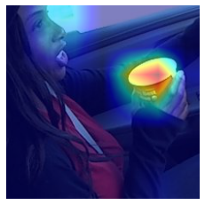
Discussion and Findings
Visualization using Grad-CAM
An explainable AI technique that can visualize feature importance to the output on the original images.
VGG16 trained without data augmentation predicting images from different classes…
C2: Talking on the phone - right
Highlighting the hand gesture
C3: Texting - Left
Highlighting the cell phone
C6: Drinking
Highlighting the cup
Notes:
We also utilize an explainable AI technique, called GradCAM, that can visualize feature importance to the output, to explain how the models make prediction.
For example, the model knows that the driver in the first image is talking on the phone by looking at his hand gesture. And the model knows that the driver in the second image is texting while the driver in the third image is drinking in that it finds the cell phone and the cup respectively.

Slide 9
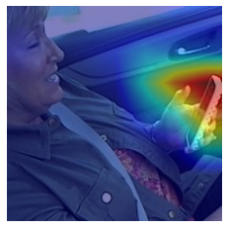
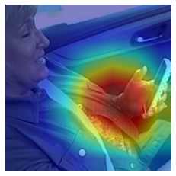
Discussion and Findings
Visualization using Grad-CAM
Why models exhibit different performance?
Evaluating different models on the same image from C3: Texting - Left
VGG16
Trained with Non-augmented Images
VGG16
Trained with Augmented Images
ResNet18
Focuses on a larger region
Notes:
GradCAM can also be used for explaining how decision-making varies from model to model. In the following example, all the three models are able to make correct classification. However, the ResNet18 model focuses on a larger region compared with the VGG16 models.

Slide 10



Discussion and Findings
Data preprocessing matters!
Naive approach
cropping the image to desired size for
transfer-learning.
Edge of images does not contain much information.
Cropping can be applied for efficiency if important details exist only within the specific part of the image.
Hi-Res is a nice plus for daily entertainment but is it so for computer vision?
Reduced resolution of input to baseline model for less computation.
However, it turns out to perform on-par with models that take Hi-Res input.
What about colour space?
Generally this is case-dependent.
For our task, color doesn’t do much so greyscale would be better and less computation.
Data augmentation
May impact the model’s training performance negatively
But improves the generalization ability to unseen data
224 x 224
cropped
224 x 224
augmented
64 x 64
resized, grey-scaled
Notes:
Lets talk about findings. Initially, all we did for preprocessing is to crop the original image so it fits in the transfer-learning model. However, after observing the cropped image, we realize that it contains just enough info for our task. So what we learn is that you can do cropping not only for sizing but also for capturing essential details as long as you know there is such pattern in your data.
Also you might want to consider if you really need high resolutions or in some case the color. Because in our case, we actually used a reduced-size grey-scale image as input to the baseline model simply cuz its cheaper to train. But the model turns out to work just as good if not better than the models with higher-resolution inputs.
Date augmentation worth a special mentioning here as it mighe not be the best model in testing. It’s got the best accuracy in live vedio prediction so it seems like augmentation still benefits the prediction by adding robustness to the viewing angle and movement

Slide 11
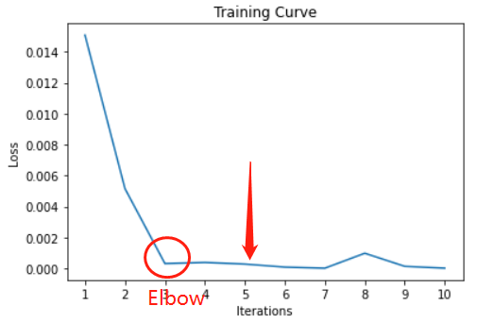
Discussion and Findings
Early Stopping
The more epochs the more converged is the training?
According to our experiments, it is not the case. Additional epochs make the training curve noisy and seemingly overfitting.
A golden rule would be to look for “elbow” point where loss drop the most. What we did is we select the model that is in the most stabilized phase after elbow.
Notes:
Secondly It might not always be a good thing to have more epochs. Especially in our case that good accuracy has been achieved in early ROUNDS. The additonal tranings does not seem to help and might interfere generalization.
The solution to this is early stopping, like stop when some criteria is met. Moreover, we select the optimal model to be the one in RATHER stablized phase just after elbow point to make sure we are not over-training it.

Slide 12
Thank You
Team 24
April 2022

Slide 13
Demonstration - Summary
Highlights：
Robust distracted behaviour detection on still images
Fast training time and less computation makes the real-time prediction and streaming possible
Challenges:
Required a fix camera angle. Make it less dynamic to different posture or scenarios.
The classifications on the specific object classification (drinking vs. phone) need to be improved.
Motion classification or filters need to be addressed for video based classification
Notes:
From the video in the previous, we observed the model predicted the test input reasonably accurate. Also the test result

Slide 14
Demonstration - Summary
Highlights：
Robust distracted behaviour detection on still images
Robust to different lighting scenarios due to normalization and augmentation on pre-trained data
Fast training time and less computation makes the real-time prediction and streaming possible
Challenges:
Required a fix camera angle. Make it less dynamic to different posture or scenarios.
The classifications on the specific object classification (drinking vs. phone) need to be improved.
Motion classification or filters need to be addressed for video based classification
Notes:
From the video in the previous, we observed the model predicted the test input reasonably accurate. Also the test result

